Slide 1


Group project presentation
Aman Regmi
Jharana Manandhar
Devid Karki

Slide 2
Links
Video Demonstration
YouTube: https://www.youtube.com/watch?v=LcXKUZzReJo
Snapshots
GitHub: https://github.com/Devid23/Online-Event-Management-System

Slide 3
Project Name | Event Organizer
Project Purpose: | Event Organizer is an application for users and organizers to manage events online and in a simple way. Anyone who wants to book an event at various available venues or who wants to list his or her property as the venue can register. It provides ease in booking events at any venue as per the user’s wish and it is completely online. Event Management is one of the most important things which will be carried out by event organizers. There are various events that can be organized by organizers for their customers. Once a user logs in he or she can check the available venues, check the cost of each venue, food items and equipment provided by the organizers or venue owner, book events at the venue, and can make payments online. On the other hand, organizers can keep records of events booked at their venue.
Anticipated Completion | Within 4 months of project initiation
Approved Budget: | Up to $20,000.
PROJECT CHARTER

Slide 4
KEY PARTICIPANTS
Participant | Position | Primary Responsiblities
Jharana Manandhar | Project Manager | Organize, plan, and manage the entire project, from activity and resource planning to meet deliveries within the timeframe.
Devid Karki | Team lead | Assisting the product's success through the SDLC processes and motivating the team.
Aman Regmi | Developer and Logistic Administrator | Implementation of website planning, involvement in server-side and client-side coding, supervision of the data warehouse, inventory control and customer service.

Slide 5
PROJECT SCOPE MANAGEMENT
Plans and documents for scope management from the project charter and project plan are created.
The project scope is created, which entails creating a successful website that will assist everyone.
Informed team members' roles and responsibilities are defined by a formal Breakdown of Work Structure.
A performance report will be created after the product has been successfully delivered.

Slide 6


GANTT CHART

Slide 7
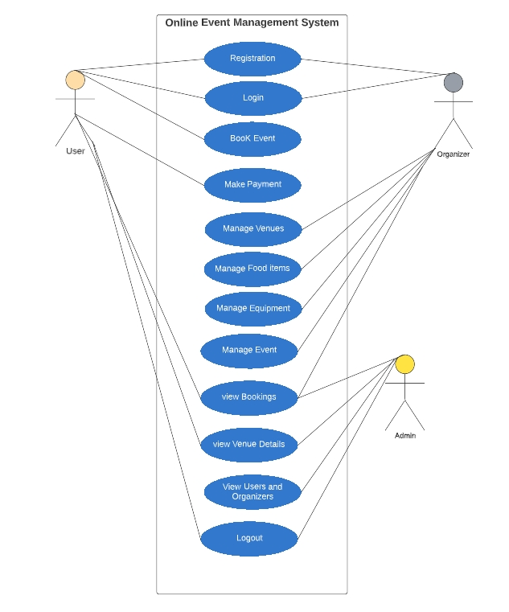
Use case diagram

Slide 8
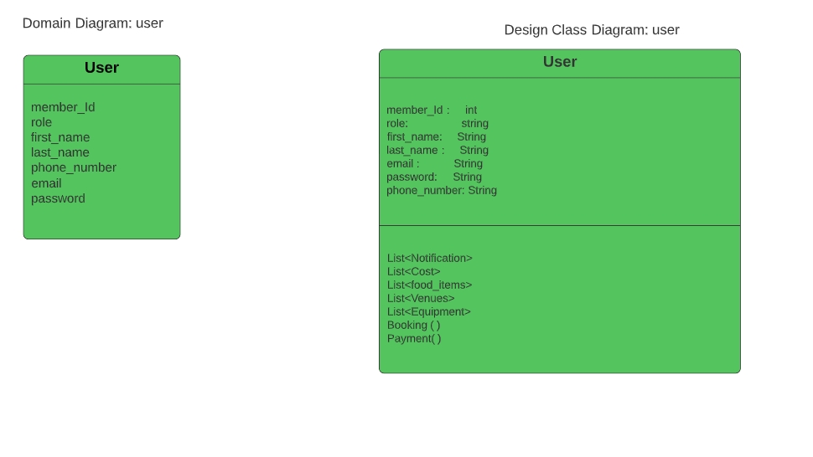
Domain Class Diagram: user

Slide 9
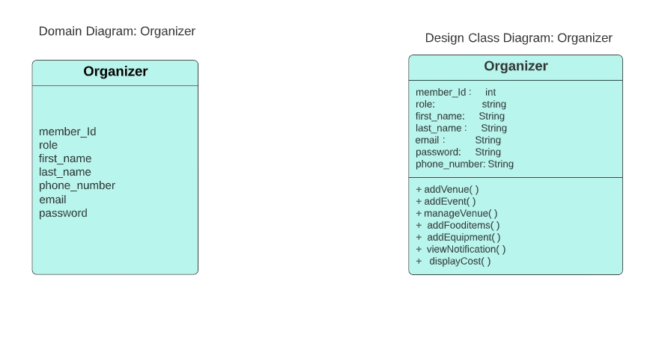
Domain Class Diagram : Organizer

Slide 10
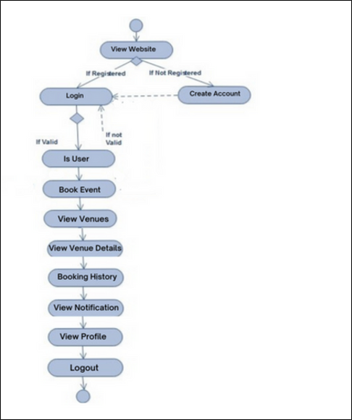
Activity Diagram
When a customer wants to reserve a venue/ event

Slide 11
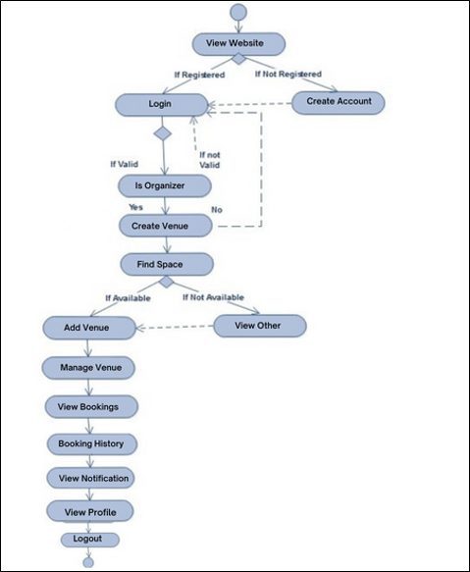
Activity Diagram
When event organizers want to publish or create events or venue’s availability

Slide 12
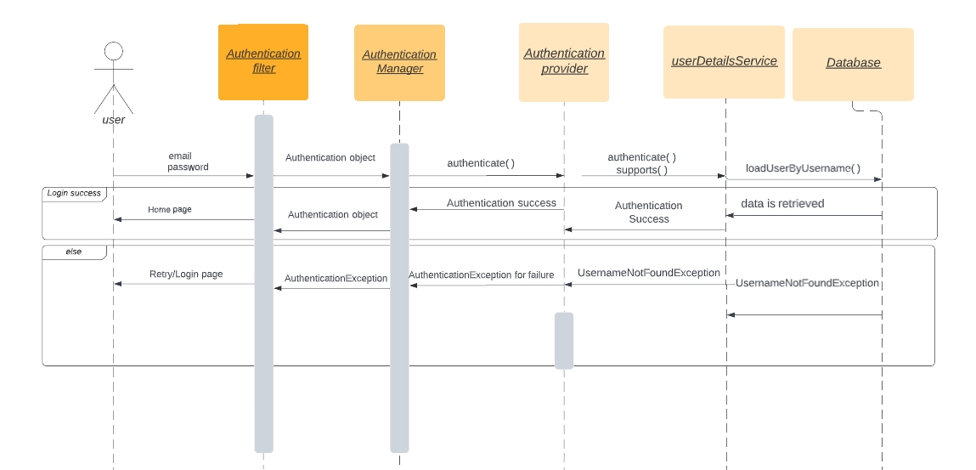
System sequence diagram/login
User will enter login credentials, and the information is intercepted by Authentication filter. Authentication Filter will send authentication object to the manager, which then implements authenticate() method. It will call authentication provider which then calls authenticate() and support method. UserDetailService will use loadUserByUsername() method to fetch data from database
Authentication is performed by Authentication Provider, and success notification plus homepage is redirected to the user if the credentials are valid.
UsernameNotFoundException notification is sent to the user if the user information is not found in the database.

Slide 13
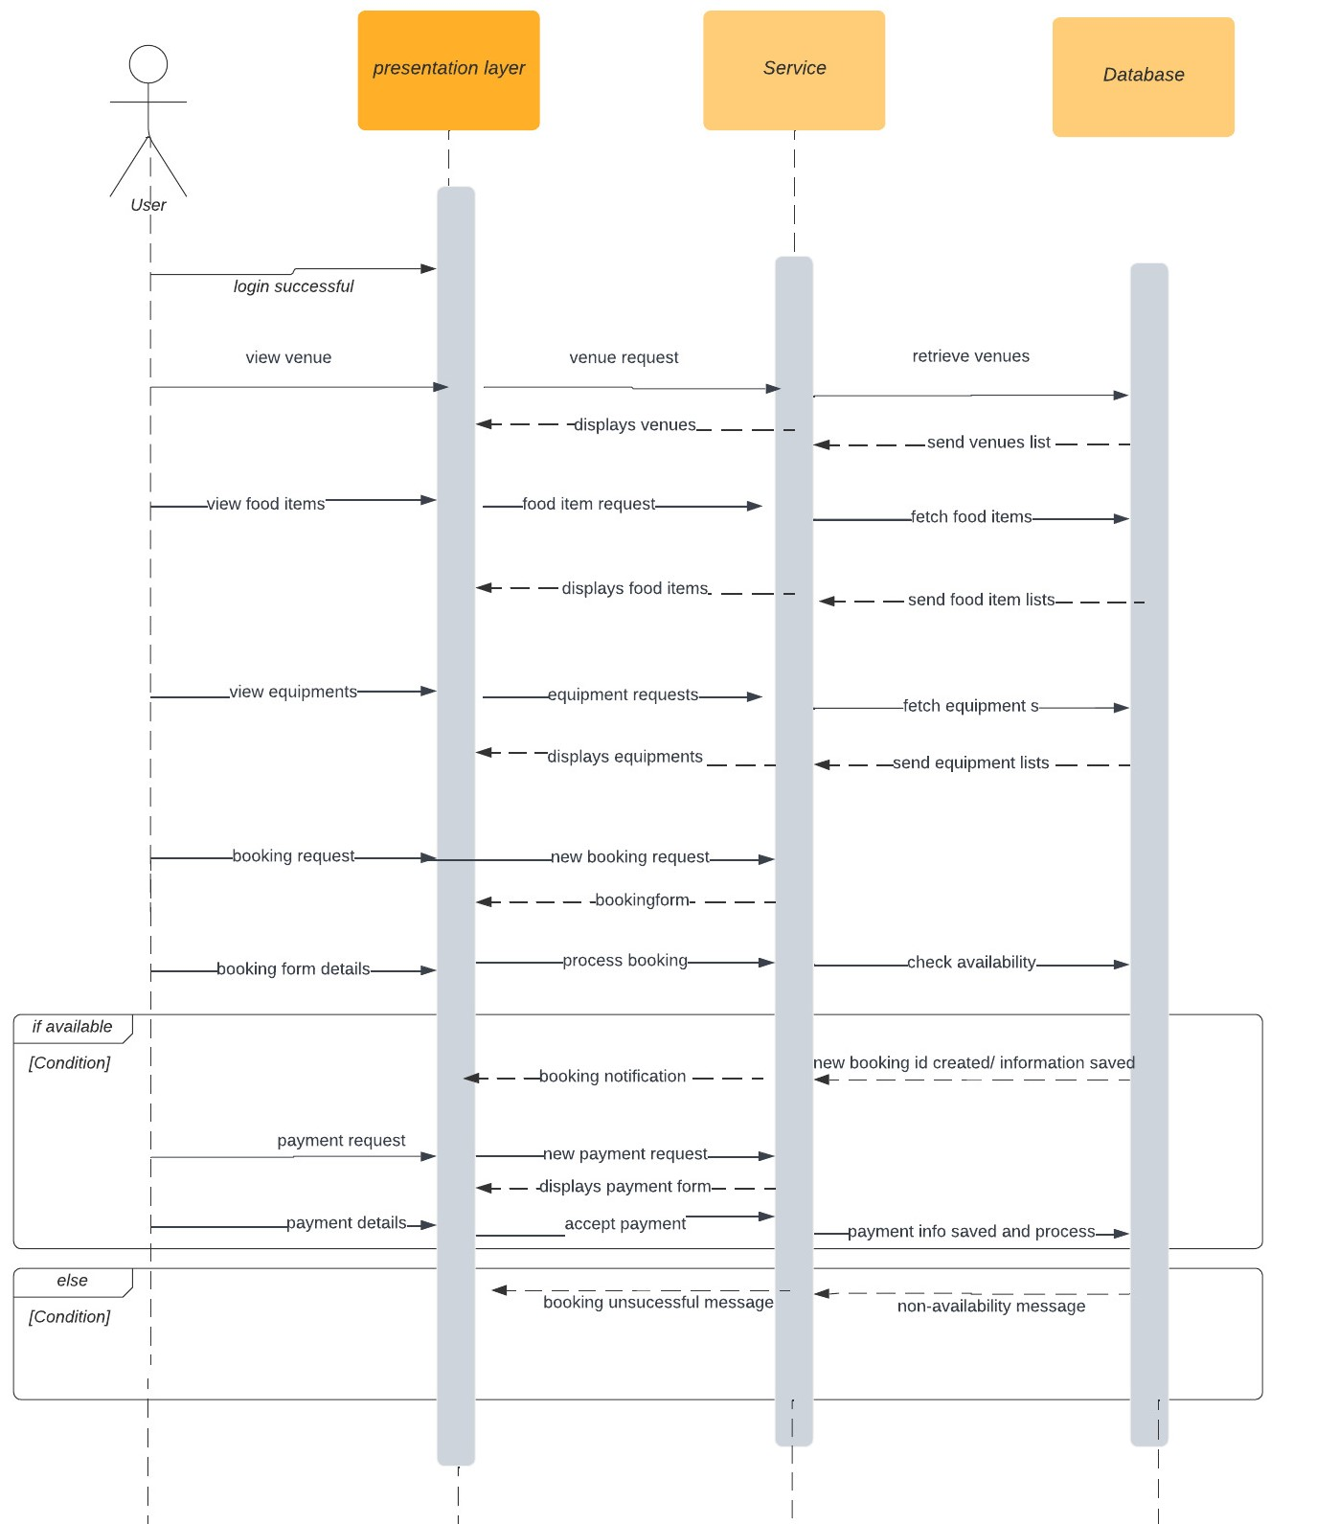
System Sequence Diagram: Event booking
1. Presentation layer will receive view venue, view food items and view equipment data from user, and presentation later will send view requests to service later. Service layer will connect and fetch data from database. Finally, service layer will provide details to the user through presentation layer.
2. User can decide to book available venues, and User will have to fill up booking form(which is provided by service layer) through presentation layer. After the booking details is provided, service layer will check the availability with database. If available, database will create new booking id and send booking notification.
3. Presentation layer will prompt user to enter payment details. And service layer will accept, and save payment information to database
4. If booking details aren't available in database, then booking unsuccessful message is displayed to the user.

Slide 14
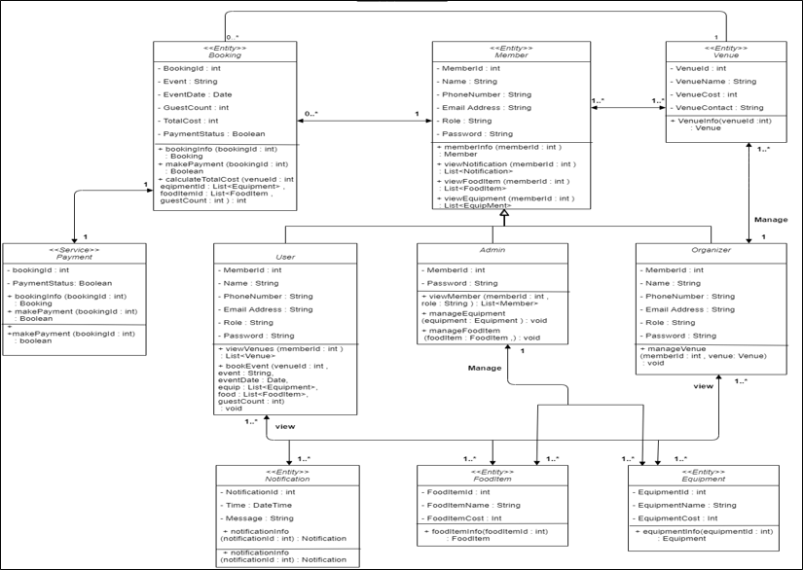
Design Class Diagram

Slide 15
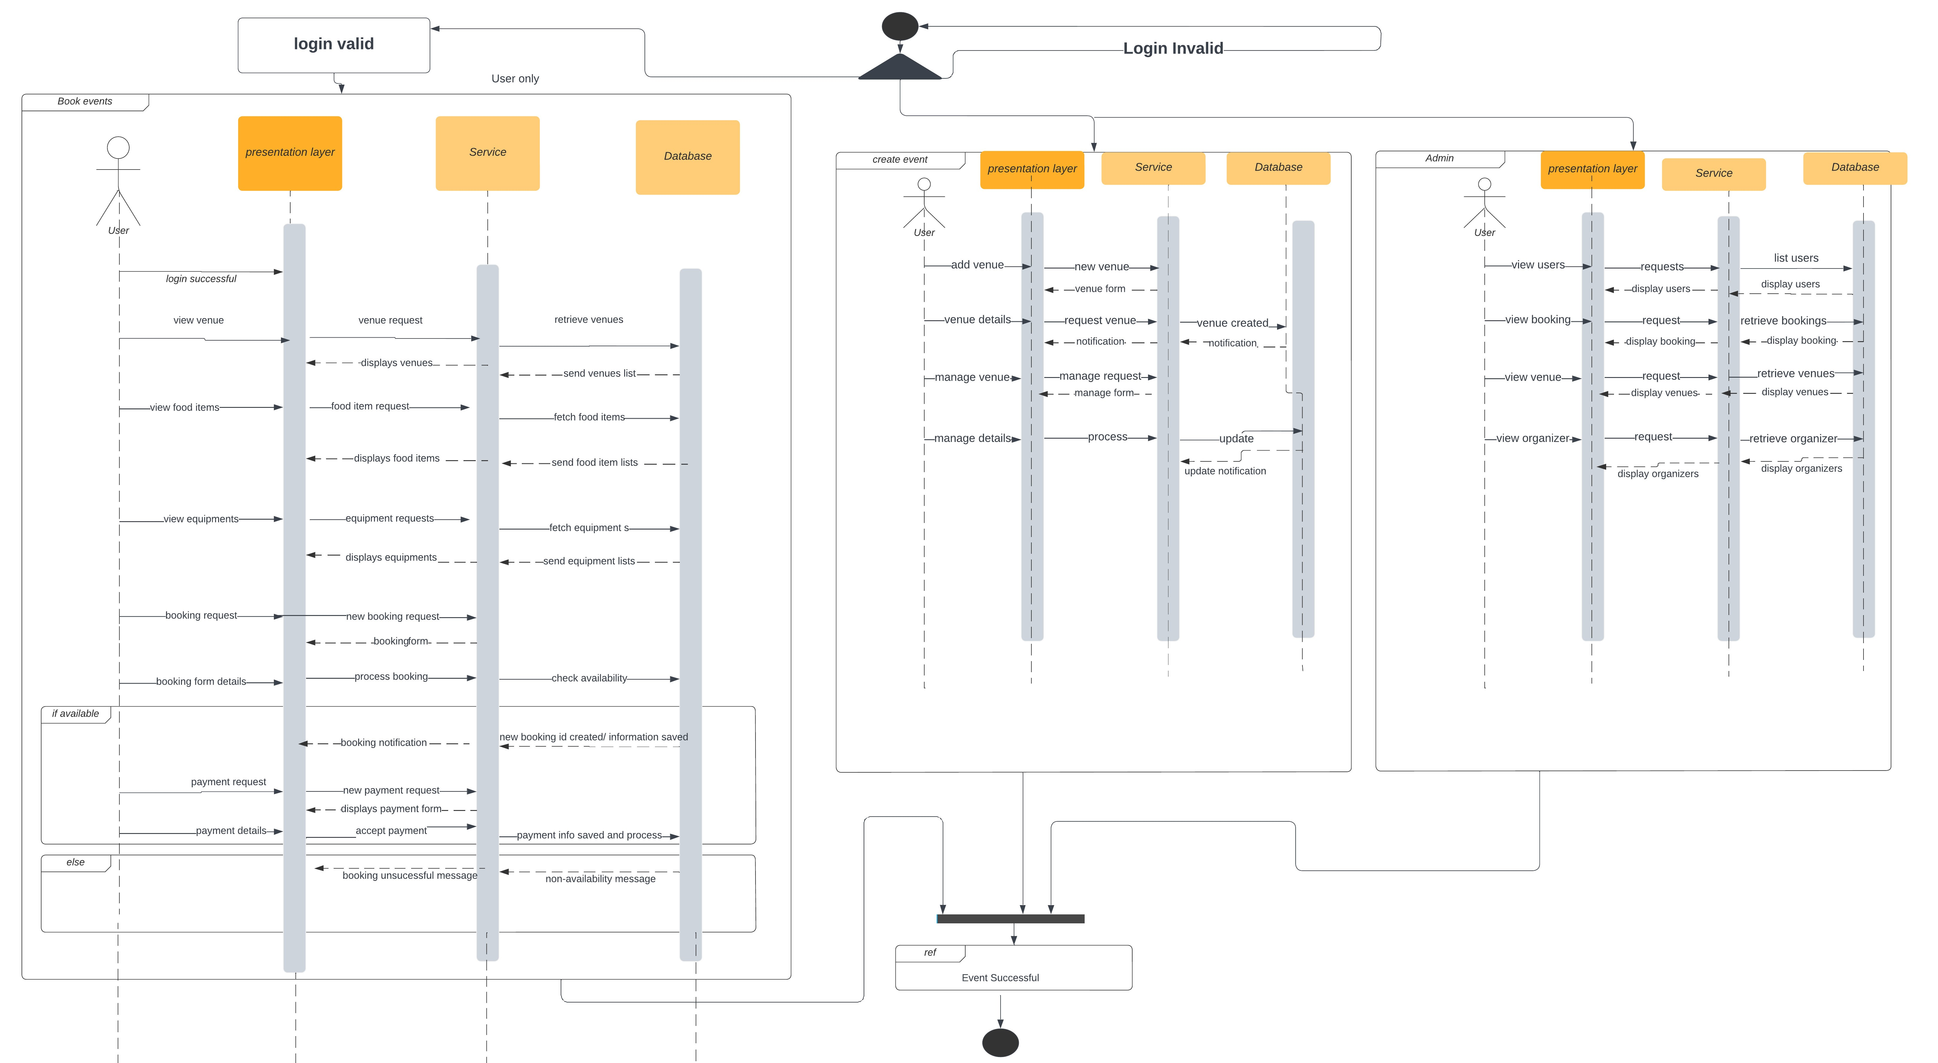
Interaction diagram

Slide 16
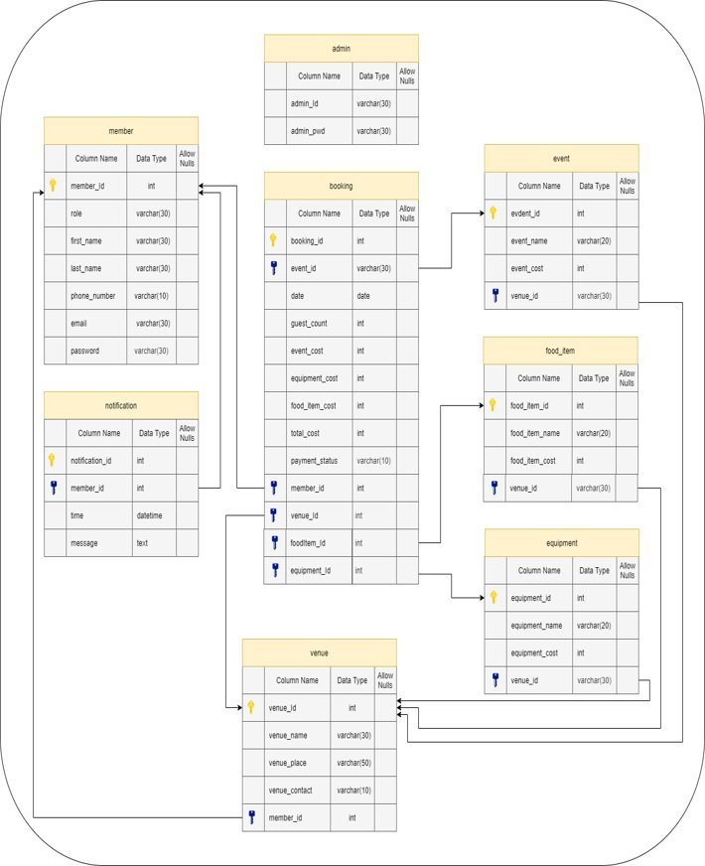
Database Models

Slide 17
Tables Structure
Admin
Field Name​ | Field Type​ | Data Type​ | Mandatory ​ | Possible Values​
admin_id​ | Text​ | varchar​ | Yes​ | Pre-loaded​
admin_pwd​ | Text​ | varchar​ | Yes​ | Pre-loaded​
Members
Field Name​ | Field Type​ | Data Type​ | Mandatory ​ | Possible Values​
member_id​ | Numeric​ | int​ | Yes​ | Autogenerated​
member_type​ | Drop Down​ | varchar​ | Yes​ | ​
first_name​ | Text​ | varchar​ | Yes​ | ​
last_name​ | Text​ | varchar​ | Yes​ | ​
phone_number​ | Text​ | varchar​ | Yes​ | ​
Email​ | Text​ | varchar​ | Yes​ | ​
password​ | Text​ | varchar​ | Yes​ | ​

Slide 18
Tables Structure
Venues
Field Name​ | Field Type​ | Data Type​ | Mandatory ​ | Possible Values​
venue_id​ | Numeric​ | int​ | Yes​ | Autogenerated​
venue_name​ | Text​ | varchar​ | Yes​ | ​
venue_place​ | Text​ | varchar​ | Yes​ | ​
venue_cost​ | Numeric​ | int​ | Yes​ | ​
venue_contact​ | Text​ | varchar​ | Yes​ | ​
member_id​ | Numeric​ | int​ | Yes​ | ​

Slide 19
Tables Structure
Bookings
Field Name​ | Field Type​ | Data Type​ | Mandatory ​ | Possible Values​
booking_id​ | Numeric​ | int​ | Yes​ | Autogenerated​
event_type​ | Drop Down​ | varchar​ | Yes​ | ​
event_date​ | Date​ | date​ | Yes​ | ​
guest_count​ | Numeric​ | int​ | Yes​ | ​
venue_cost​ | Numeric​ | int​ | Yes​ | ​
equipment_cost​ | Numeric​ | int​ | Yes​ | ​
food_item_cost​ | Numeric​ | int​ | Yes​ | ​
total_cost​ | Numeric​ | int​ | Yes​ | ​
payment_status​ | Text​ | varchar​ | Yes​ | ​
member_id​ | Numeric​ | int​ | Yes​ | ​
venue_id​ | Numeric​ | int​ | Yes​ | ​
foodItem_id​ | Numeric​ | int​ | Yes​ | ​
equipment_id​ | Numeric​ | int​ | Yes​ | ​

Slide 20
Equipment
Field Name​ | Field Type​ | Data Type​ | Mandatory ​ | Possible Values​
equipment_id​ | Numeric​ | int​ | Yes​ | Autogenerated​
equipment_name​ | Text​ | varchar​ | Yes​ | ​
equipment_cost​ | Numeric​ | int​ | Yes​ | ​
Tables Structure
Food Items
Field Name​ | Field Type​ | Data Type​ | Mandatory ​ | Possible Values​
food_item_id​ | Numeric​ | int​ | Yes​ | Autogenerated​
food_item_name​ | Text​ | varchar​ | Yes​ | ​
food_item _cost​ | Numeric​ | int​ | Yes​ | ​

Slide 21
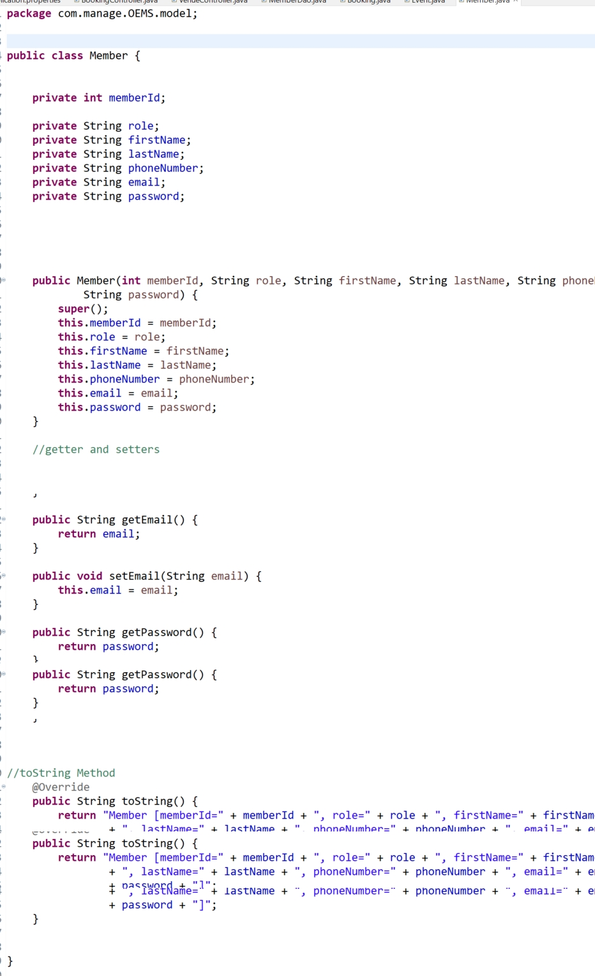
Sample code for Member Entity

Slide 22
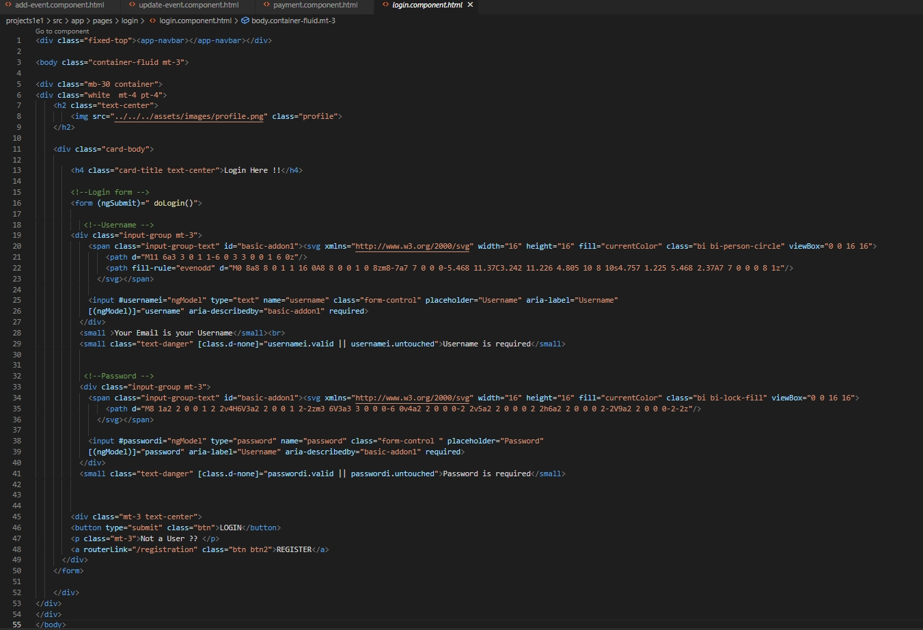
Sample Code for login html

Slide 23
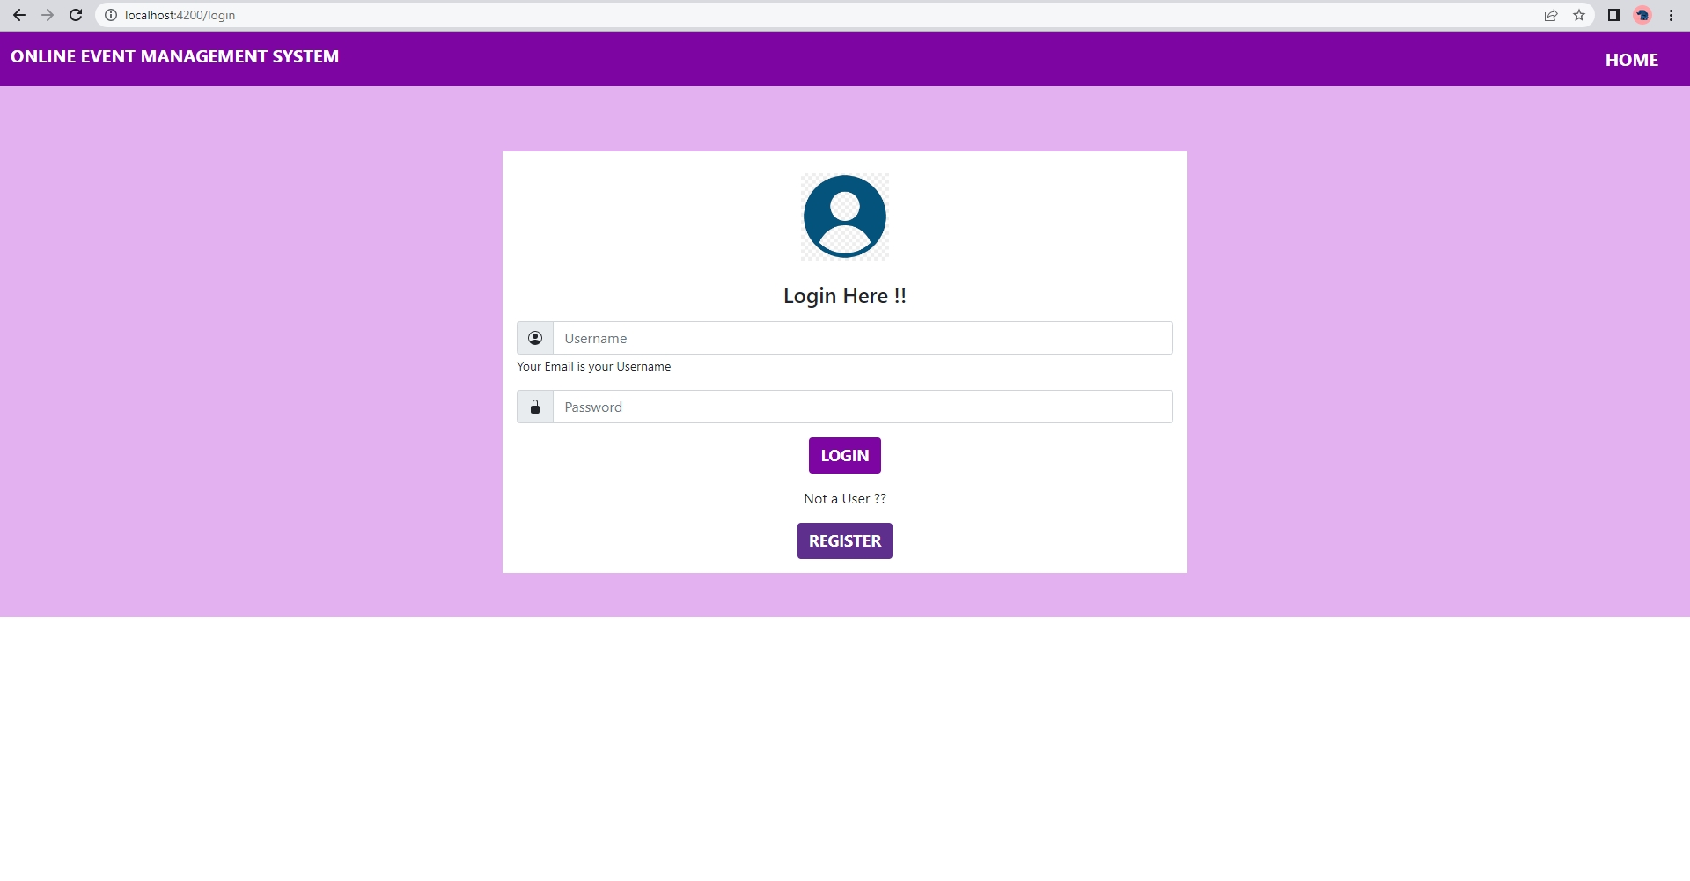
Login Page

Slide 24
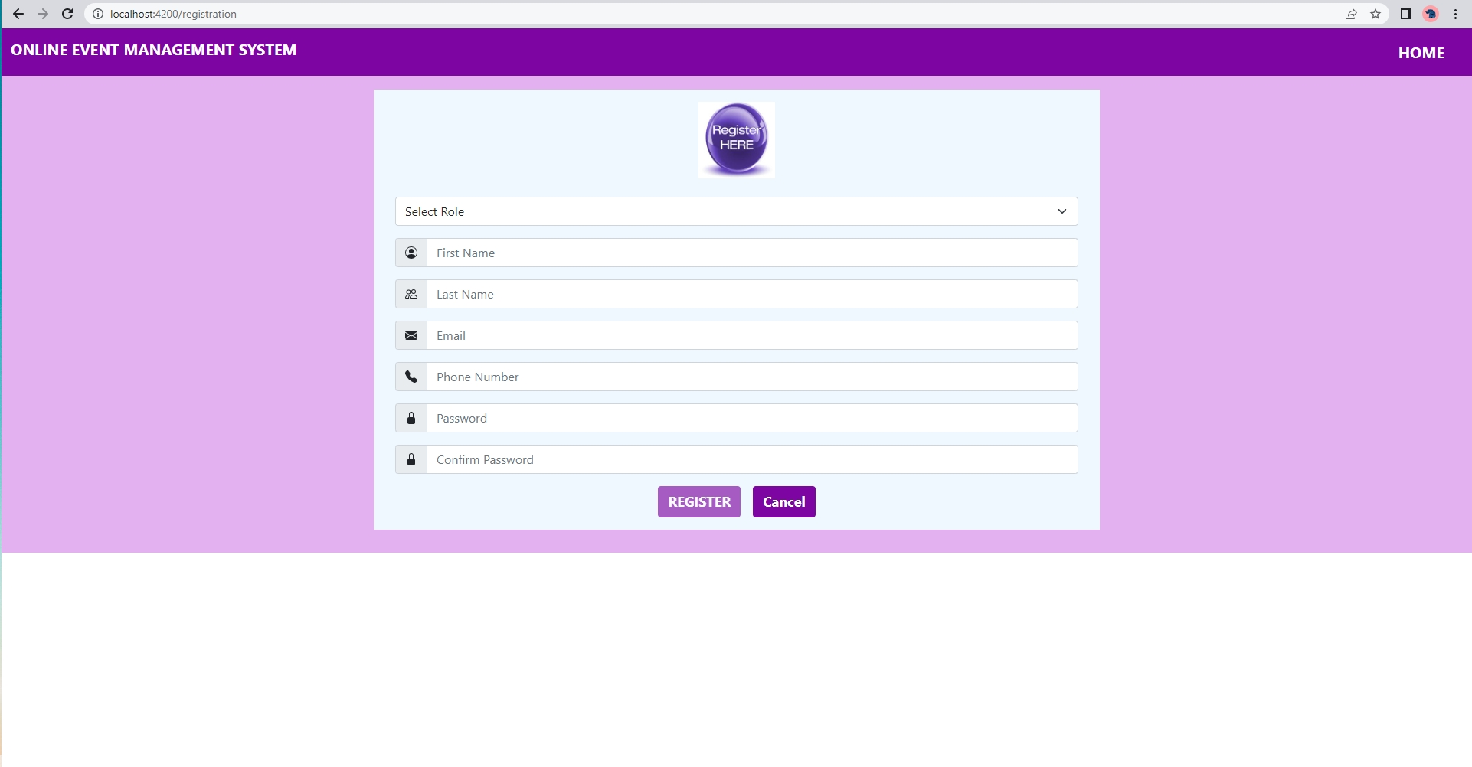
Register Page

Slide 25
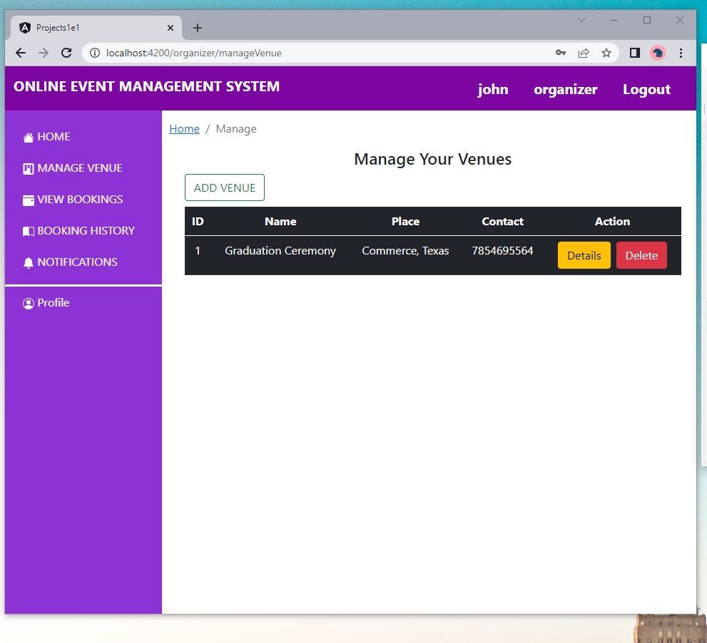
Manage Venues

Slide 26
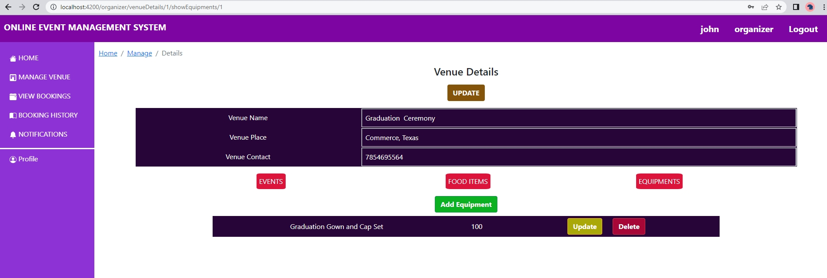
Add Events, Food Items and Equipements

Slide 27
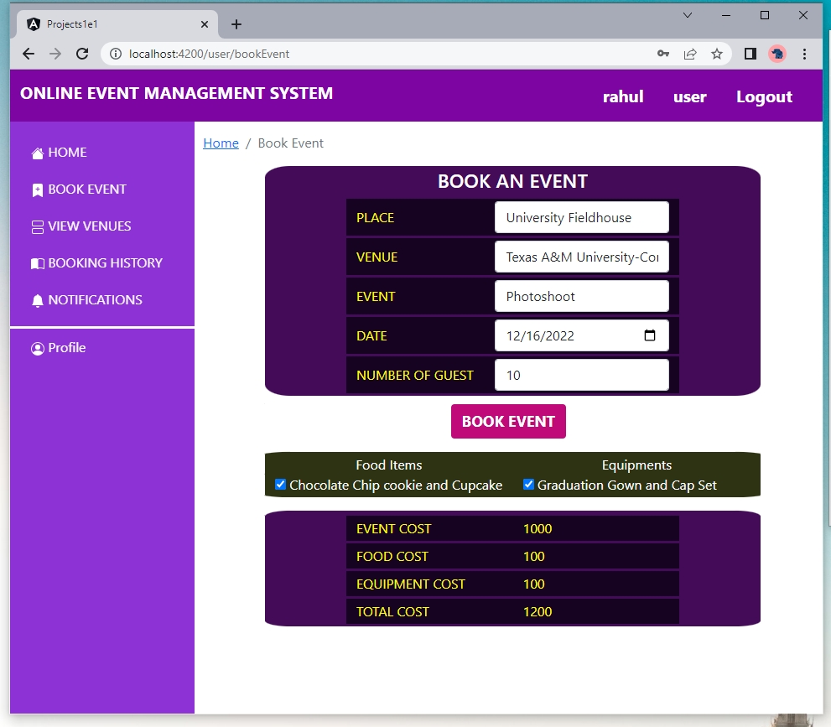
Event Booking

Slide 28
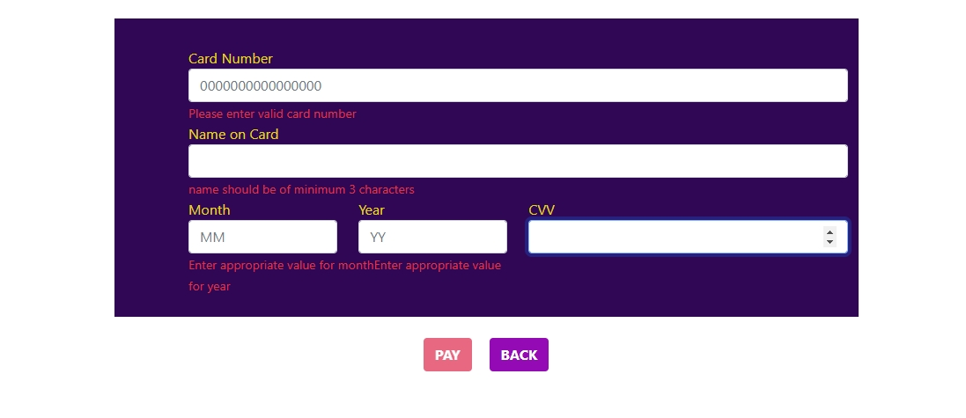
Payment

Slide 29
TEAM CONFLICTS AND SOLUTIONS
All members of our group shared ideas and gave updates on their tasks via Group Chat.
We also had to set up frequent zoom meetings to deal with the few class absences.
We added one new member to this project, and during the initial days, we had difficulty conveying the project's purpose. All team members were in shape after reviewing all our previous class presentations and project material.
Any team member who encounters a problem with the code will share it in the group chat, or remote desktop application to access the screen online to get help finding it. Most of the errors we encountered were logical errors and syntax errors.

Slide 30


